Slide 1
Tweet Categorization and Sentiment Analysis
Abhisek Mohanty

Slide 2
Overview
Document Categorization – Classification of documents into categories
Various types of document classification
Documents – texts, images, music
Text
Images

Slide 3
Text Categorization
Classification of text into categories.
Types :
Rule Based : Based on a set of classification rules. Not very promising.
Content Based : Based on weights of words, could be the number of times given word appears in a document.
For ex: Sports – team, NFL, league, goal, ace, Djokovic, Messi etc
Music – concert, gig, album, beatles, playlist, beats etc

Slide 4
Sentiment Analysis
Analyzing the contextual polarity of the text
Many applications, from movie and product reviews to stock market analysis (Though not very reliable)
A sub tree of Text Categorization.
Categories are Positive, Negative, Neutral
In other cases, depict emotional states – Happy, sad or angry

Slide 5
Other Uses of Text Classification
Spam Filters
User interest based recommendation

Slide 6
Project
Categorize tweets into 14 pre-defined categories
Trending Topics by country – 50
Tweets from each trending topic
Categorize
Sentiment Analysis on the tweets
Happiness Index for each country from the trending topics

Slide 7
Machine Learning Methods
Naïve Bayes Classifier
Support Vector Machines
Bag of Words Model
Many other models like kNN, Deep Learning etc.

Slide 8
Naïve Bayes
Probabilistic Classifiers unlike others
Simple and widely used for text classification
Simple (“naïve”) classification method based on Bayes rule
Relies on very simple representa1on of document
Bag of words

Slide 9
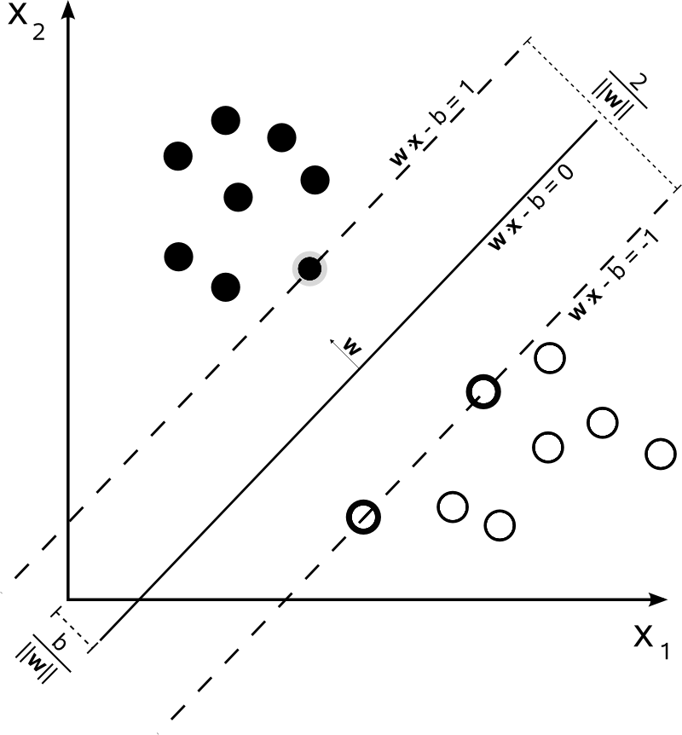
Support Vector Machines
Large Margin Classifier
Linearly Separable Cases
Slack Variables
reduce over fitting

Slide 10
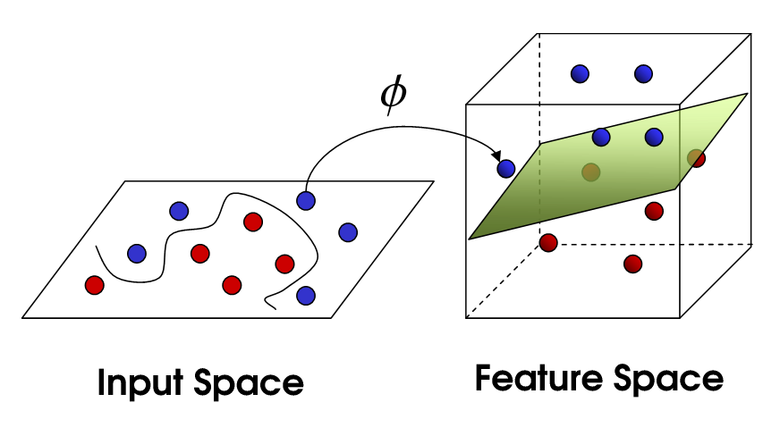
Support Vector Machines
Non Linear Cases
Kernels

Slide 11
Why SVM ??
Because :
The obvious – Large Margin Classifier
High Dimensional Feature Space
Sparsity of the training vector
Kernels

Slide 12
Project Data
Training Data
Text Categorization
Fetch Tweets for each category
Twitter API
N users for each category
Store to disk
Twitter limitations
Add category Label
Tweets Preprocessing
Train Classifiers
{
"category": "automobiles",
"tweets": [
"We ve spotted the next Vauxhall Insignia testing again",
"Has the time come for Mini to launch the Rocketman Find out why it s more likely than ever",
"See what s heading to the Beijing motor show from the local manufacturers”
]
}

Slide 13
Project Data
Training Data
Sentiment Analysis
Stanford Dataset
Tweets Labelled with their sentiment (3.6 million)
Tweets Preprocessing
Train Classifiers
Time
Approx. 4 hours for each SVM classifier

Slide 14
Data Preprocessing
Step 1 : Data Cleansing
Twitter Data
Lots of noise
Unnecessary characters, hyperlinks, usernames
Stop Words
Step 2 : Vectorization
SVM, NB Input Format

Slide 15
Vectorization
Tf-idf :
short for term frequency–inverse document frequency
Term Frequency
The weight of a term that occurs in a document.
Simplest – number of times the term appears in the text
Others : boolean, log scaled, augmented frequency
Inverse Document Frequency
Used to penalize most frequent terms.
Idf of most common terms is low
Tf-idf makes more sense
Ngrams : from tokens
Unigrams, bigrams and trigrams
Important in sentiment analysis

Slide 16
Vectorization
Document Term Matrix:
Classifiers expect vectorized input
Convert text to vectors
DT Matrix
Tf or tf-idf of each word
Followed by index of the word in the vocabulary

Slide 17
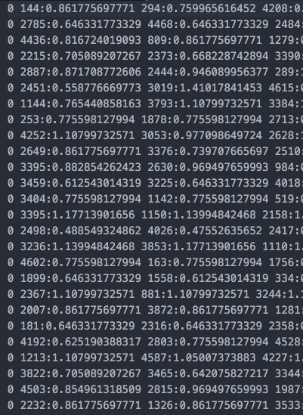
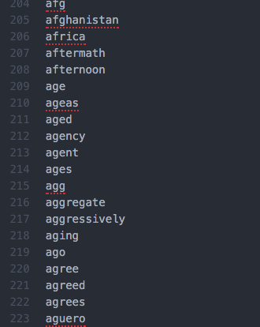
Left : Document Term Matrix Right : Vocabulary List

Slide 18
Thank You

